Slide 1
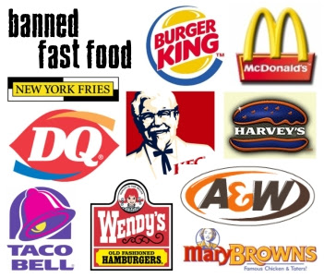

Apps that have successfully improved
the Customer engagement
for F & B Player
→ By Atharv Shah

Slide 2
About the Business. . . . .
It involves process of preparing, presentation and serving food and beverage to the customer.
It’s of two types : On premise and Off Premise
(Many industries operates on both basis)
Strategies to improve customer engagement in F&B company.
Customer Loyalty feature
Customer experience
Feedback
Customer segmentation

Slide 3
McDonald’s
Background:
Fast food industry.
Started in 1940 by Richard and Maurice McDonald.
More than 35000 franchise world wide.
Most valuable brand worth more than $25 billion
Competitors:
→ Burger king, Subway , Wendy's etc.

Slide 4
Challenges
Over the past years, McDonald’s has been facing new challenges, such as the heavy pressure to be more transparent about their food and processes. Meanwhile some of the competition has been heavily investing in digital, while McDonald’s mostly remained at the sideline. It allowed others like Starbucks and Subway to take the lead.
→Take on Burger King for low-income customers
→In a bid to be all things to all men and offer healthier alternatives to burgers and fries, some argue the menu has got too complicated. Bigger menus have made kitchen operations more complex, giving some customers a longer wait for their fast food fix.
→Slow, inaccurate service.

Slide 5

Key features
Serving up mobile coupon
Coupons like Free fries above order of Rs 249.
Buy 1 get 1 burger offers via Mobile app
Free Delivery above order of Rs 100.
Spotlighting mobile metrics
Sending offers based on the location.
Providing registration loyalties to increase registration rates.
Hence it’s objective was to increase the customer engagement

Slide 6
KFC
Background:
→ Most popular chicken restaurant chain.
→Started in 1930 by colonel Harland Sanders.
→Part of the YUM’s Brands Inc.
→ More than 35000 locations around the world.
→ Brand worth more than $10B
→Unique recipe with 11 Herbs.

Slide 7
CHALLENGES
Unhealthy and greasy food.
Prices not in economic ranges as compared with franchise like al-beik.
Improper Supply chain management which results in lot of operative charges, hence unable to decrease the retail cost.
(All of them adversely affect the customer Engagement. )

Slide 8

KEY FEATURES
Ease Payment system to enhance customer
experience.
(global payment platform Adyen to support its in-app payments which had begun in UK)
→ The pre-ordering feature.
AI enables technology for accurate customer segmentation to enhance supply chain management.

Slide 9
THANK YOU

